Slide 1
Climate Change : An Urban Myth?
Mini Project 3

Slide 2
CONTENTS
NO | DESCRIPTION | NO | DESCRIPTION
1 | BUSINESS PROBLEM | 6 | ANALYSIS
2 | DATA PROBLEM | 7 | RESULTS
3 | STAKEHOLDERS | 8 | RECOMMENDATIONS
4 | DATASETS | 9 | NEXT STEPS
5 | BACKGROUND | - | -

Slide 3
1. BUSINESS PROBLEM
As part of the Company’s Corporate Social and Environmental Responsibility (CSER), each Department is to present current social or environmental issues in the next Town Hall to raise awareness and propose on ways the Company can improve.
Your boss has nominated you to represent the Analytics Department.
2. DATA PROBLEM
Using information available on global temperature as topic for environmental issues, present your findings and proposed improvements.

Slide 4
3. STAKEHOLDERS
Analytics Team
The Company
Colleagues at Town Hall
Singapore

Slide 5
4. DATASETS
The 3 separate datasets are as follows : -
Dataset 1 – “Global Average Temperatures”, consists of 9 columns :
Date : From years 1750 to 2015
Land and Ocean Average Temperature and Uncertainty
Max and Min Land Temperature and Uncertainty
Dataset 2 – “Global Land Temperatures By Major City”, consists of 7 columns :
Date : From years 1849 to 2013
Average Temperature and Uncertainty
City and Country
Latitude and Longitude
Dataset 3 – “Global Average Land Temperature by Country”, consists of 4 columns :
Date : From years 1743 to 2013
Average Temperature and Uncertainty
Country

Slide 6
5. BACKGROUND
Saving the Planet or Us?
Earth has gone through immense climate changes many, many times before : the “ice ages” or “interglacials”. In some cases leading to mass extinctions. But life persisted.

Slide 7
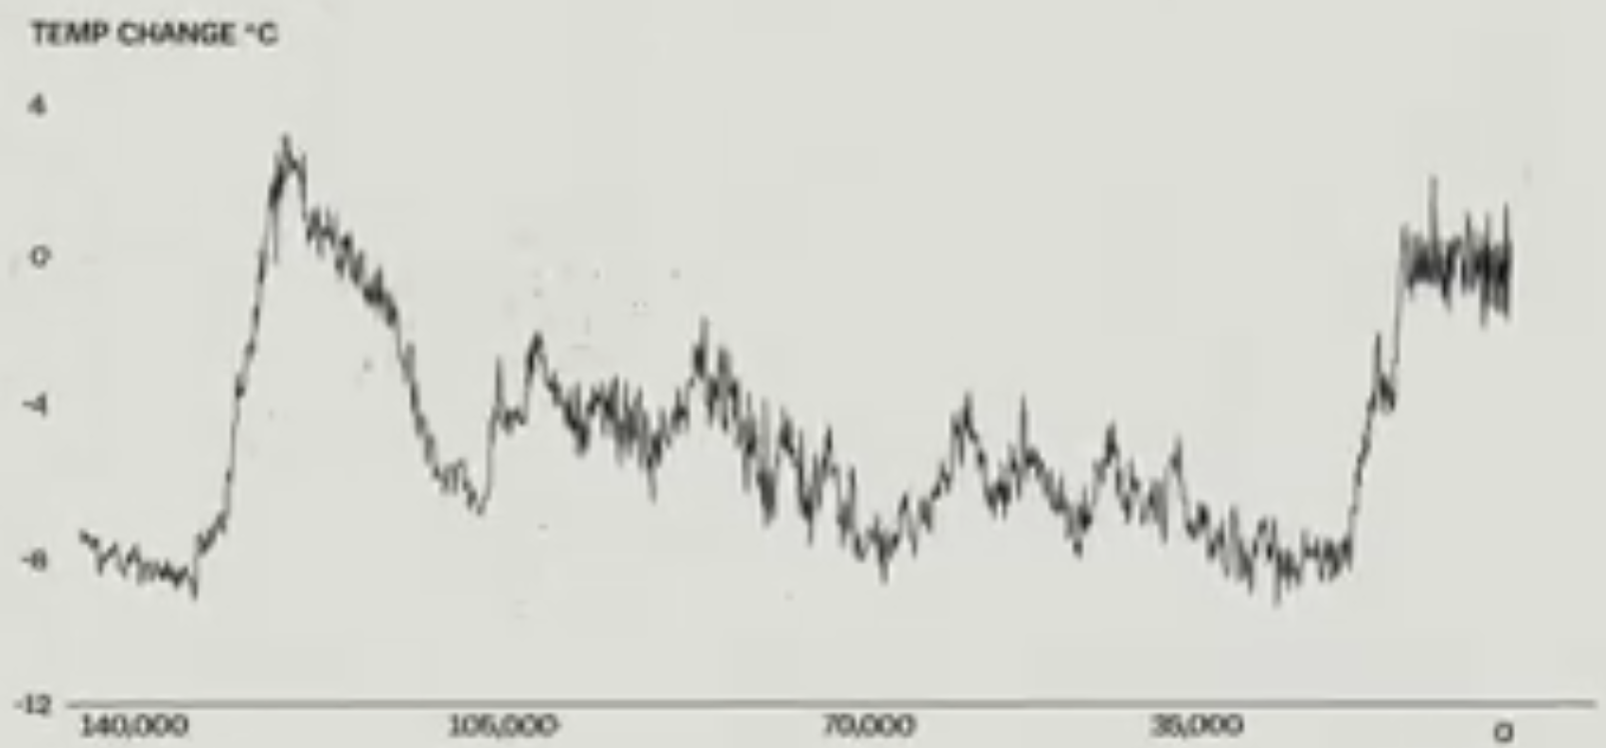
5. BACKGROUND
PAST
PRESENT
Vostok Ice Core Data, Paleoclimatology Data Contribution Series

Slide 8
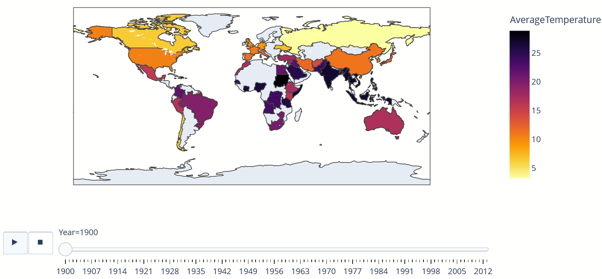
5. BACKGROUND – Global Average Temperature °C from Years 1900 to 2013

Slide 9
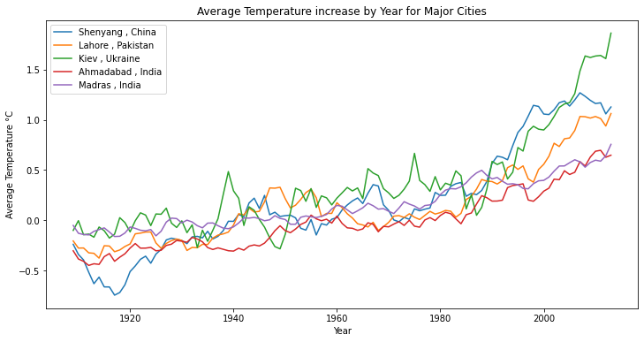
6. ANALYSIS – Average 1°C Increase
In span of 20 years
Proving climate change is not a myth

Slide 10
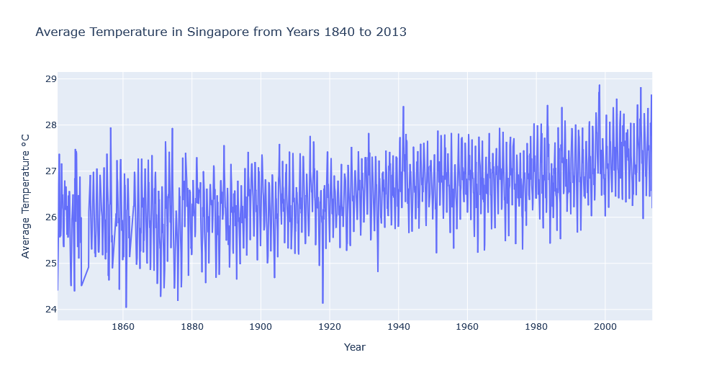
6. ANALYSIS – Singapore

Slide 11
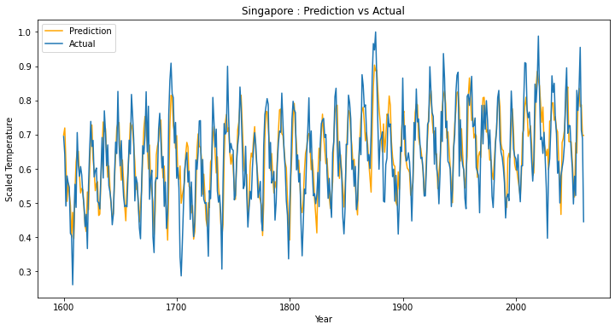
6. ANALYSIS – Artificial Neural Network LSTM
R2 Score = 0.66, Mean Square Error = 0.36

Slide 12
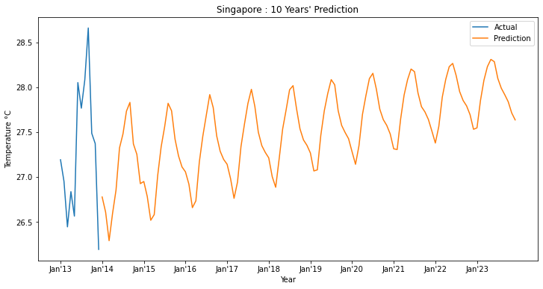
7. RESULTS – Forecast with Trained Model

Slide 13
8. RECOMMENDATIONS AND PROPOSAL FOR IMPROVMENTS IN THE COMPANY
RENEWABLE ENERGY
COMMUNITY PROJECTS
CARBON FOOTPRINT
To consider one time investment in renewable energy sources
Company can organise Community Outreach Programmes - Volunteering time in ocean / community cleaning projects
Reduce carbon footprints by taking public transport and less flying ie replaced with meetings via zoom

Slide 14
9. NEXT STEPS FOR MODEL IMPROVEMENT
LATEST DATA
DAY ANALYSIS
MORE LAYERS
Year 2013 to current
Instead by month
Try more hidden layers

Slide 15
THANK YOU

